Slide 1

Lightweight Embedded Security Protection System under RISC-V Architecture
FYP by Charlie (Bofu Chang)
Bofu Chang, an Automation student from Harbin Institute of Technology, Shenzhen.
Interested in software coding and hardware application.

Slide 2
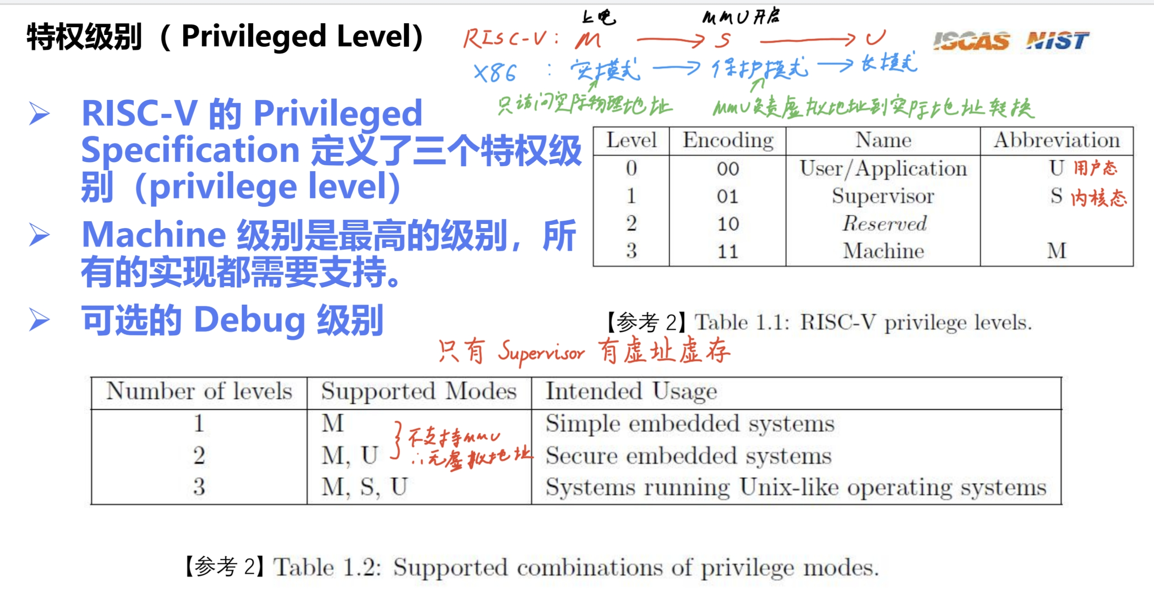
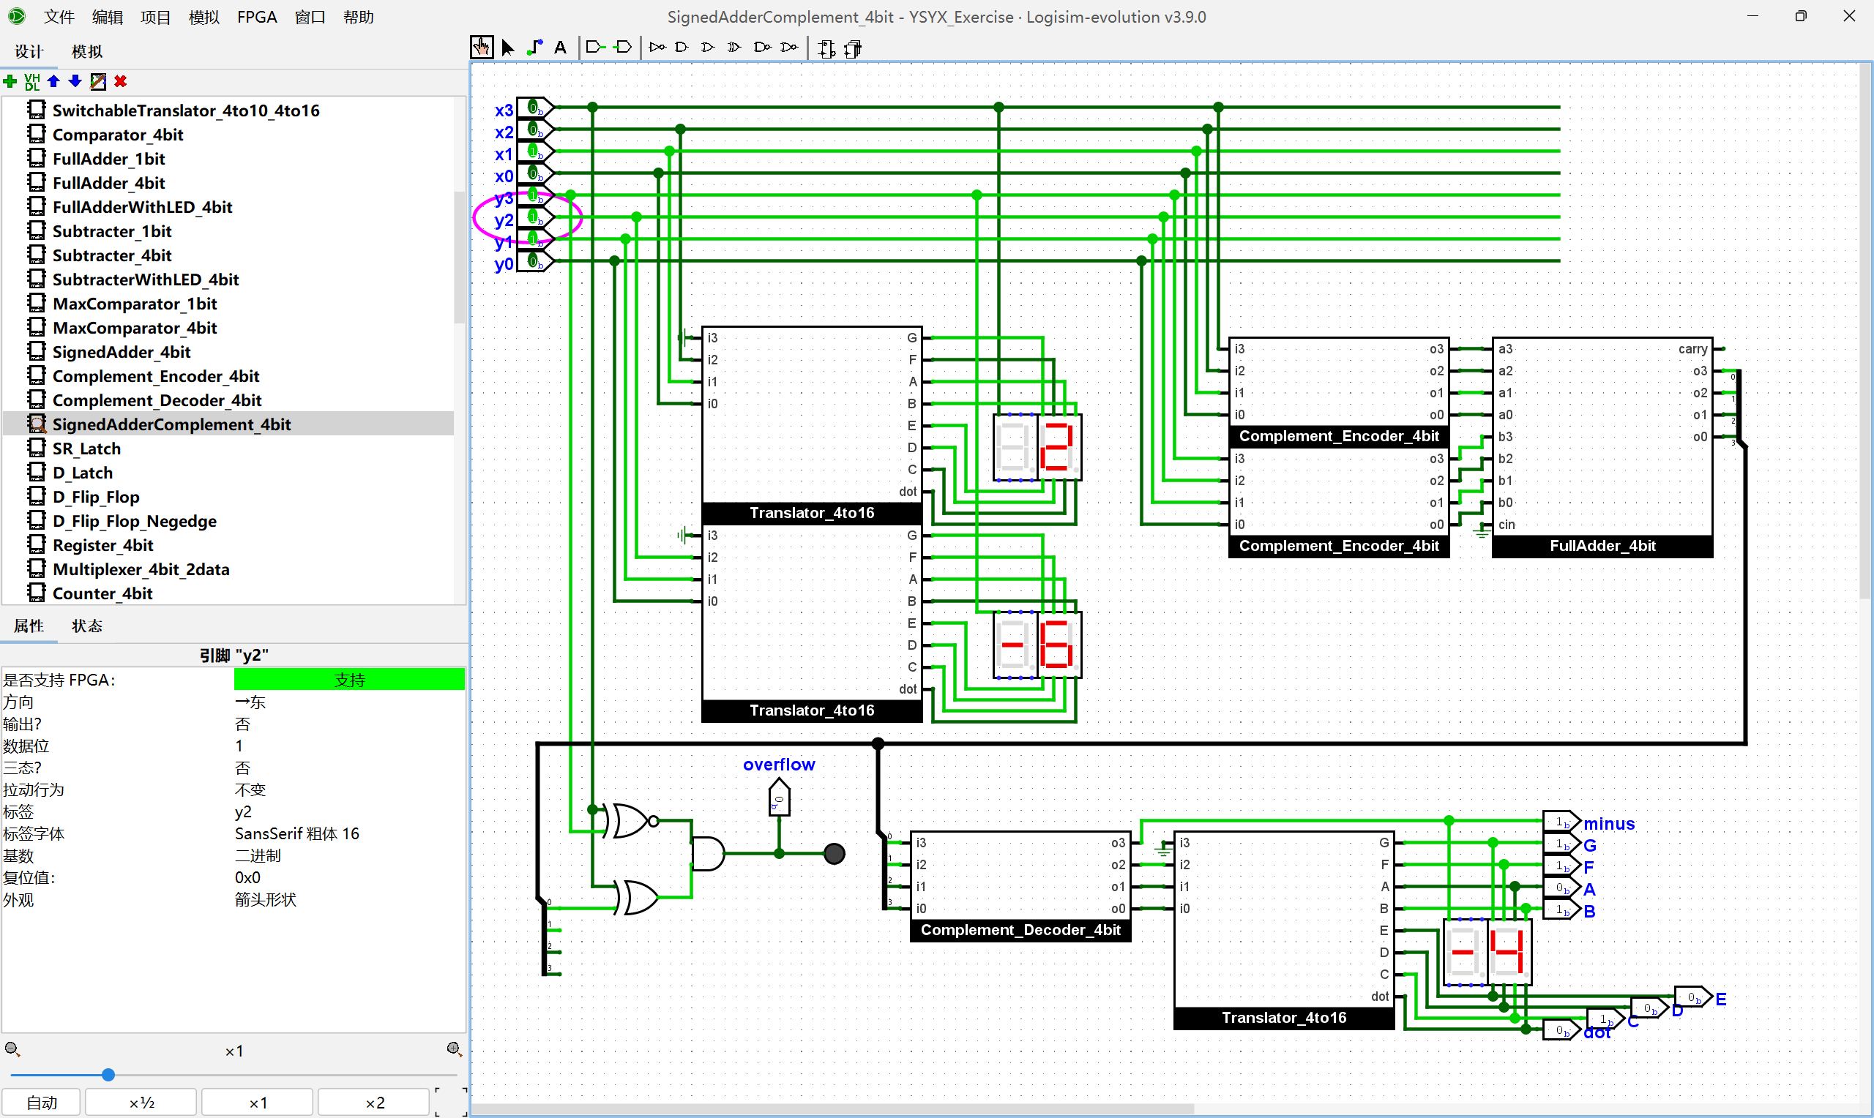
Pre-FYP Progress
Learning basic knowledge of RISC-V
Following YSYX and reviewing DC knowledge

Slide 3
FYP Timeline 0.0
Sept - Oct
2025
Literature research: security vulnerability cases, current protective plans
Learn RISC-V privileged architecture and PMP module, simulate RISC-V core by QEMU
Oct - Nov
2025
Design hardware encryption module: write logic of simplified AES-128 by Verilog
Connect encryption module (Xilinx Artix-7) and RISC-V development board (GD32VF103)
Nov - Jan
2025 - 2026
Permission isolation module: write PMP configuration code in M mode
Integrate modules into RISC-V development board and debug the logic of inter-module calls
Feb - Mar
2026
Determine the requirements of the protection system
Hardware function verification using oscilloscope
Encryption and verification module: write simplified SHA-256 by C++ and driver of AES module
Mar - Apr
2026
Attack simulation test: buffer overflow attacks and firmware tampering
Graduation thesis and thesis defense
Performance optimization: reduce memory usage and increase speed of the encryption module
Compatibility test: Verify system functionality on different RISC-V boards (like Nuclei N307)

Slide 4
Sept. 5 – Sept. 12 2025 Week 1 Progress
Literature research

Slide 5
Determine the scope of the research
Vulnerability type
Permission isolation failure
Firmware tampering
Side-channel attack
Interface abuse
Protective technologies
PMP (Physical Memory Protection)
Privilege level mechanism
Hardware encryption
Secure boot
Application scenarios
Resource-constrained embedded devices

Slide 6
SoC Platform Security: Why RISC-V? A Survey and Analysis on SoC Platform Security in ARM, Intel and RISC-V Architecture, Nicholas et al
Proprietary Architectures
Open-source Architecture
ARM TrustZone
Vulnerable to cache-based side-channel attacks
Intel SGX
Vulnerable to enclave malwares
Also vulnerable to cache-based side-channel attacks
Main reason: lack of flexibility
RISC-V
Different privilege modes
Sanctum Model
RISC-V MultiZone Security
Adding security features to the existing model
Anti Side-channel Attacks: implement different countermeasures in the existing framework
Facilitates the open community to participate in finding and fixing security vulnerabilities

Slide 7
Sept. 12 – Sept. 19 2025 Week 2 Progress
Literature research & Refreshed FYP timeline

Slide 8
An Exploration on Various Possible Solutions (Part I)
Dimensions | CM32M433R (Hardware Encryption) | CM32M433R (Software Encryption) | Kendryte KD233 (Hardware Encryption)
Price (2025) (CNY) | 112 (Tax included) | Same as left | 220
Power Consume(Typical) | Low (≈50mA) | Extra ≈10% consumption | 300mW (Idle)
Encryption Performance (AES-128) | ≥110KB/s (144 MHz, DMA) | 10~15KB/s (tiny-AES-c) | ≈80KB/s (K210 datasheet)
Permission Isolation | 8, support M/S/U mode | Same as left | 8, only M mode
Firmware Tampering | Hardware Verification (OTP) | Software Verification (Bootloader) | Bootloader (without hardware enforcement)
Side-channel Attack | TRNG Mask + Dynamic Random Delay | TRNG Mask | Software mask (K210 TRNG)
Interface Abuse | Peripheral Registers Lock + Interruption Monitoring | Same as left | SPI registers lock (only M mode, no dynamic monitoring)
Development Difficulty | Low (Nuclei Studio) | Same as left | Medium (CH340 issues)
Applicable Scene | Lightweight industrial control, IoT | Low-cost verification | Edge AI + Lightweight Security

Slide 9
An Exploration on Various Possible Solutions (Part II)
Dimensions | GD32VF103 + ATECC608B | GD32VF103 + Artix-7 | Sifive Hifive1 Rev B (Halt Production)
Price (2025) (CNY) | 80 + 50 = 130 | 80 + 1000~2000 | ≈500 before halt
Power Consume(Typical) | Low (≈30mA + ≈0.03μA) | High (FPGA ≈1W) | ≈80mA
Encryption Performance (AES-128) | 50KB/s (without I2C cost) | 200KB/s (Encryption module under Verilog, without I2C cost) | ≈100KB/s
Permission Isolation | 4, only M mode | Need custom MPU for FPGA | 8, support L locking bit
Firmware Tampering | Hardware & Software cooperation | VF103 Software Verification | Hardware Verification (Hifive1 HSM)
Side-channel Attack | 608B Built-in Protection | FPGA Custom Mask | Software mask
Interface Abuse | VF103 PMP + 608B Interface Whitelist | Custom bus monitoring | PMP + Peripheral Access Whitelist
Development Difficulty | Medium (Dual-bus Communication) | High (Verilog + Dual-bus Communication) | Medium (Freedom Studio)
Applicable Scene | Ultra-low-cost IoT | Customized Encryption | -

Slide 10
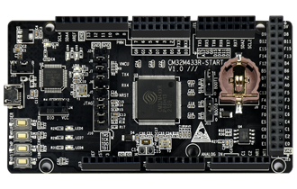
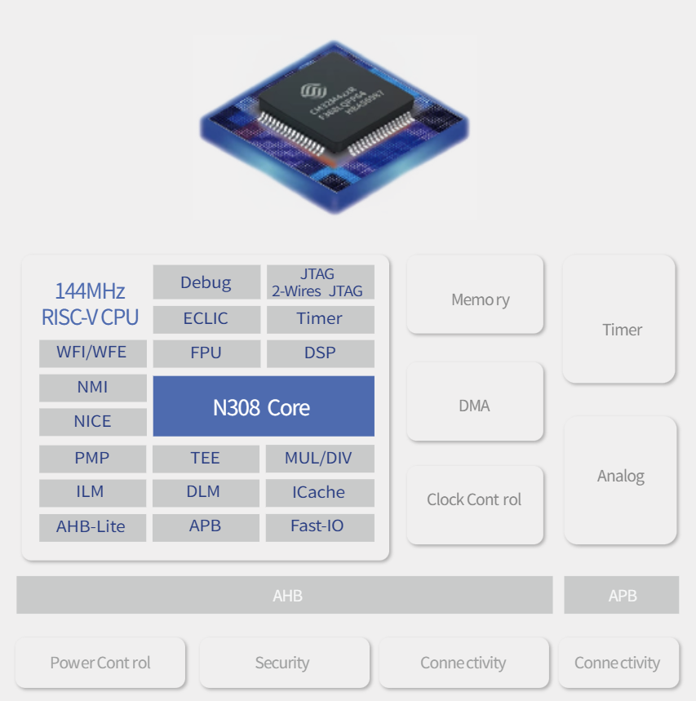
Final Solution: CM32M433R
Hardware Encryption (AES-128)
SAC module, support AES-128/192/256 and CBC/ECB/CTR modes
Permission Isolation (PMP)
8 programmable regions, each can be configured with R/W/X permissions
Can lock sensitive addresses (AES register, SPI register)
Firmware Tampering Protection (OTP + FLASH verification)
OTP stores the SHA-256 baseline value
FLASH supports hardware ECC verification (1-bit error correction / detection)
Side-channel Attack Protection (TRNG mask)
Invoke TRNG to generate an 8-bit random mask
XOR mask the input data in AES
Interface Protection (PMP locks SPI register, GPIO lock)

Slide 11
FYP Timeline 1.0
Sept - Oct
2025
Install Nuclei Studio, complete GPIO lighting up, enable UART debugging
Oct - Nov
2025
Hardware / software AES development
Nov - Jan
2025 - 2026
Hardware / software side-channel protection
Feb - Mar
2026
Mar - Apr
2026
Mid-term oral examination
Graduation thesis & thesis defense
Literature research / review
Thesis proposal
Hardware / software firmware verification
Hardware / software interface protection
System integration & encryption stress test
Conduct negative tests
Collect data and materials

Slide 12
Sept. 19 – Oct. 3 2025 Week 3-4 Progress
Get familiar with hardware & Literature research

Slide 13
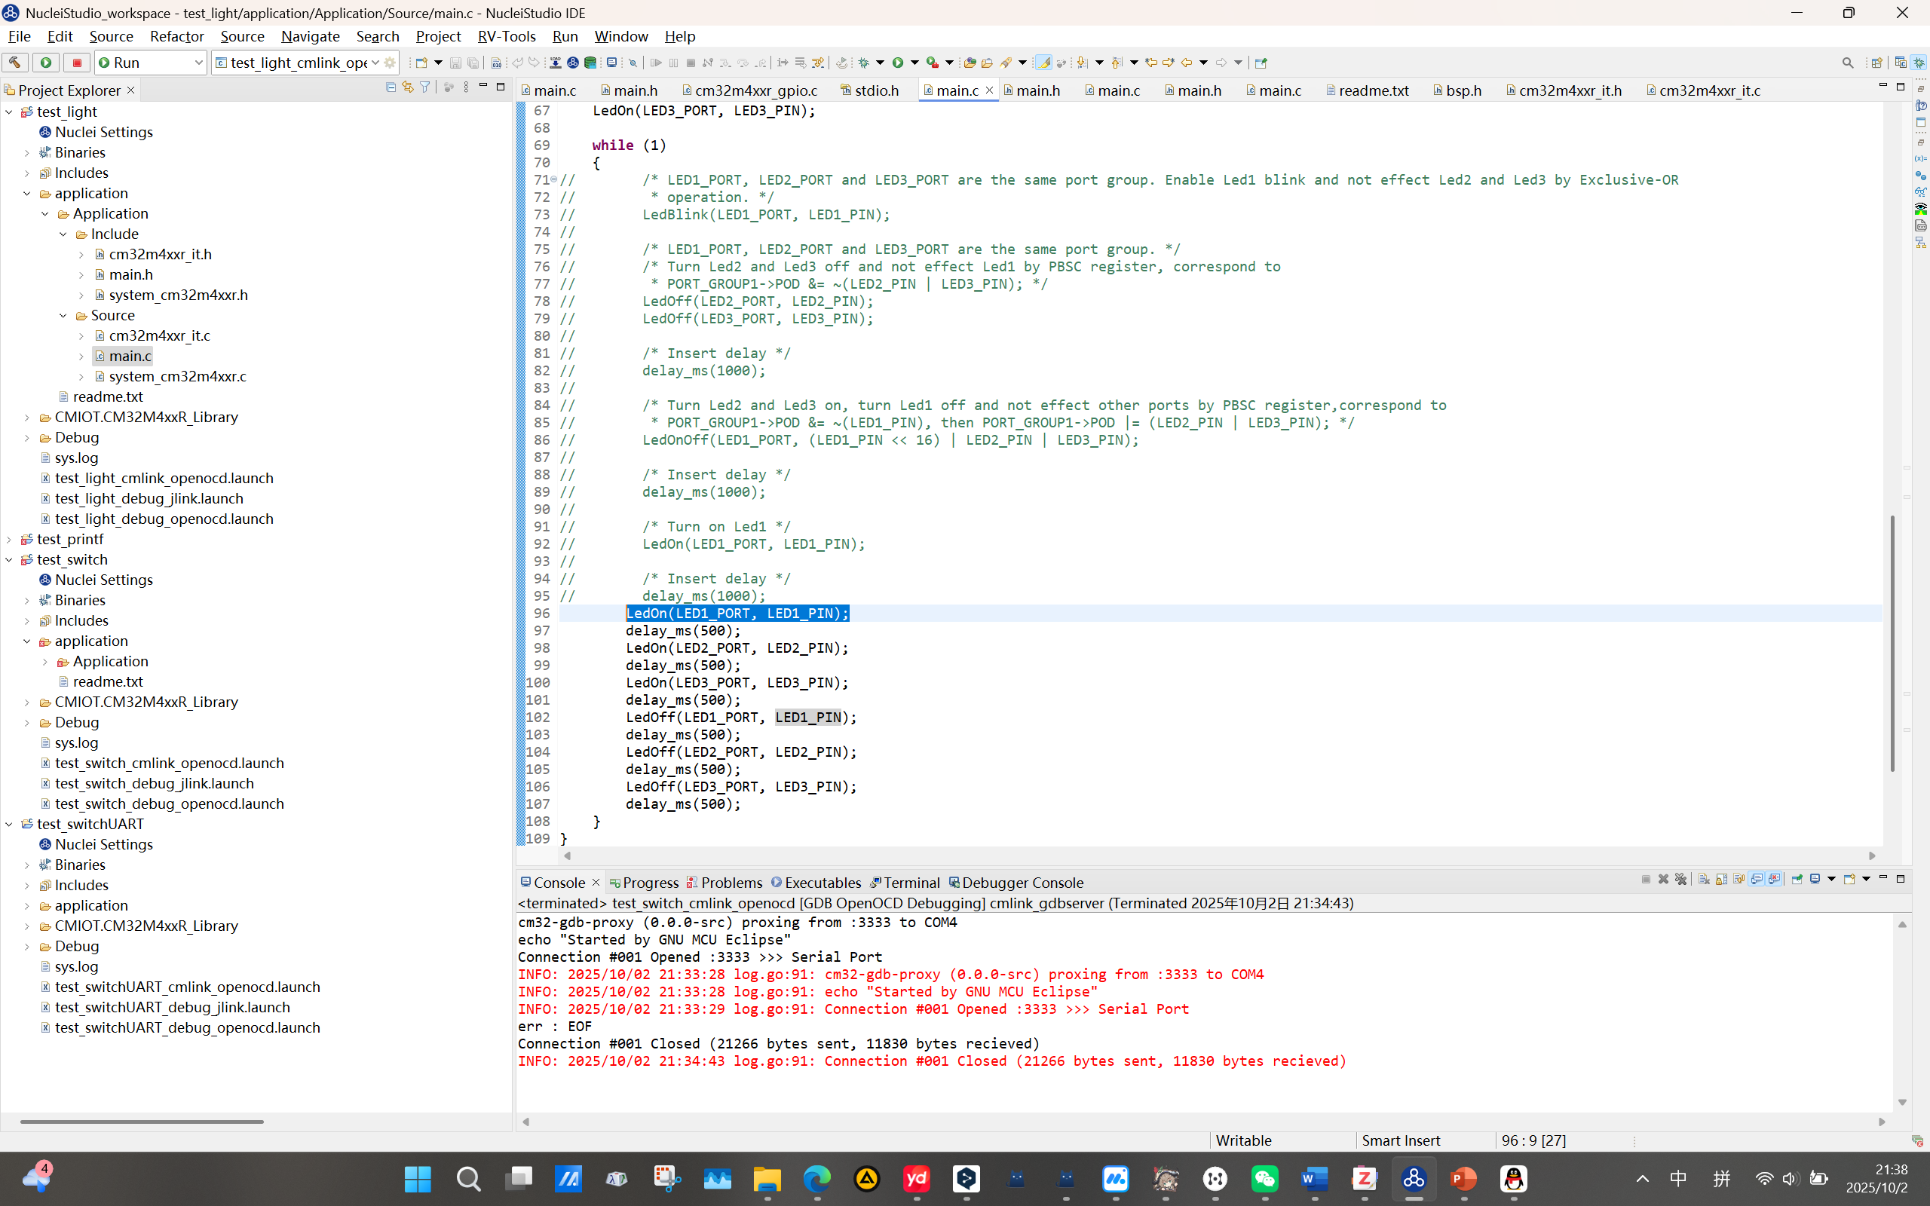
Get Familiar with Hardware - Blink

Slide 14
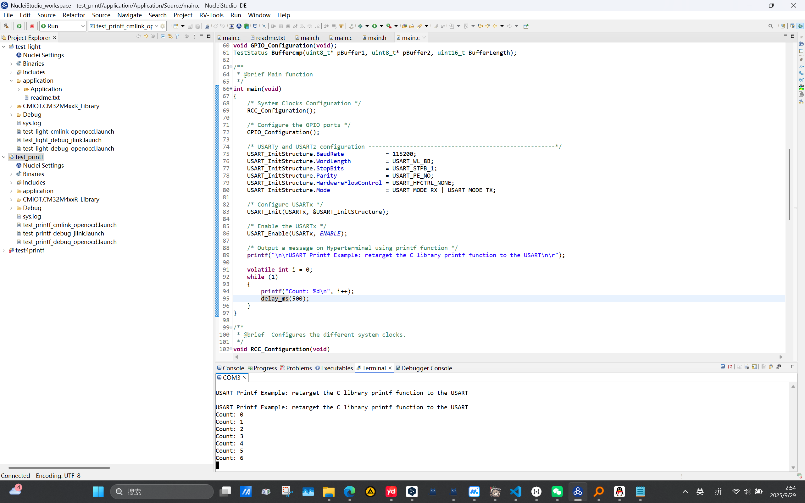
Get Familiar with Hardware – USART printf test

Slide 15
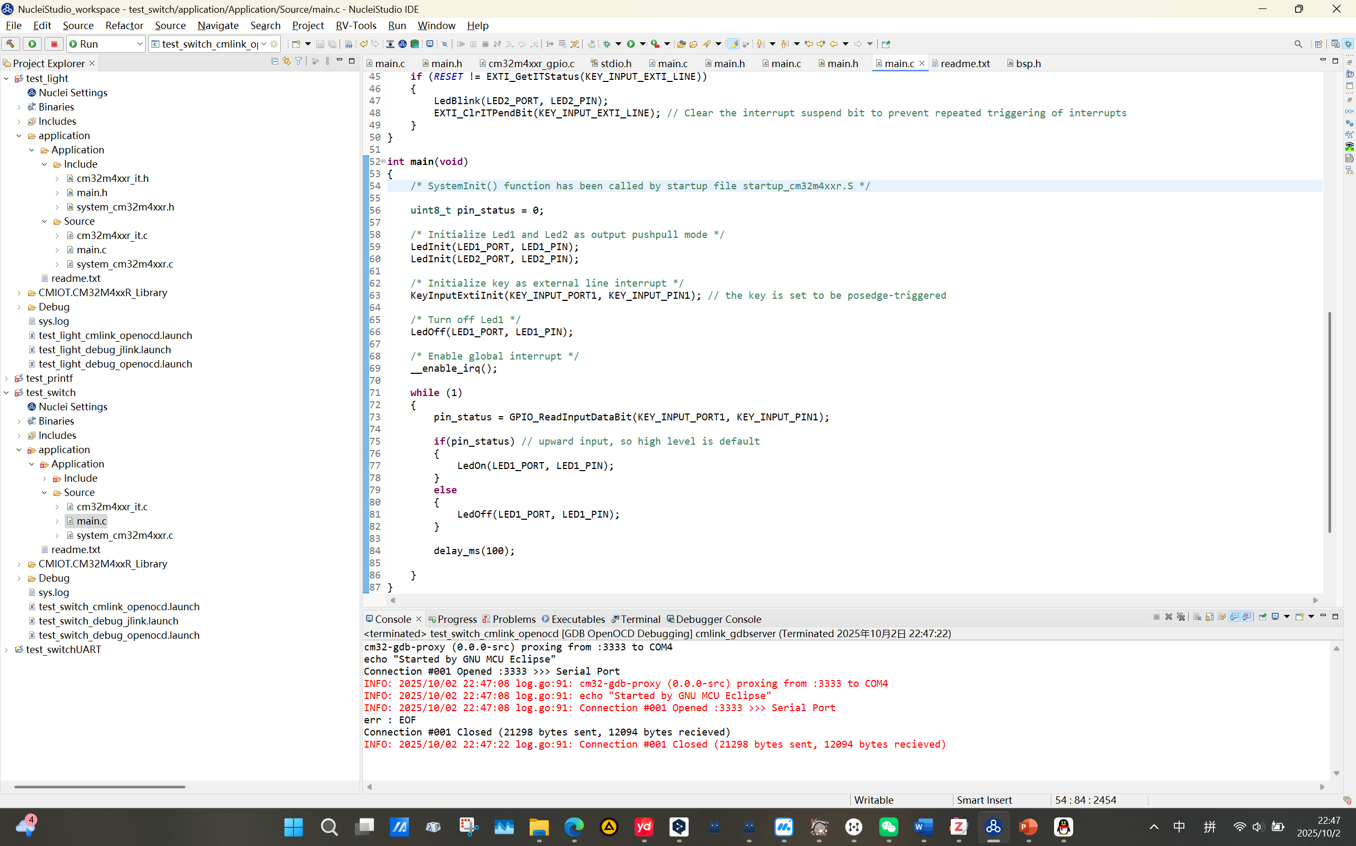
Get Familiar with Hardware – Switch & External Interrupt

Slide 16
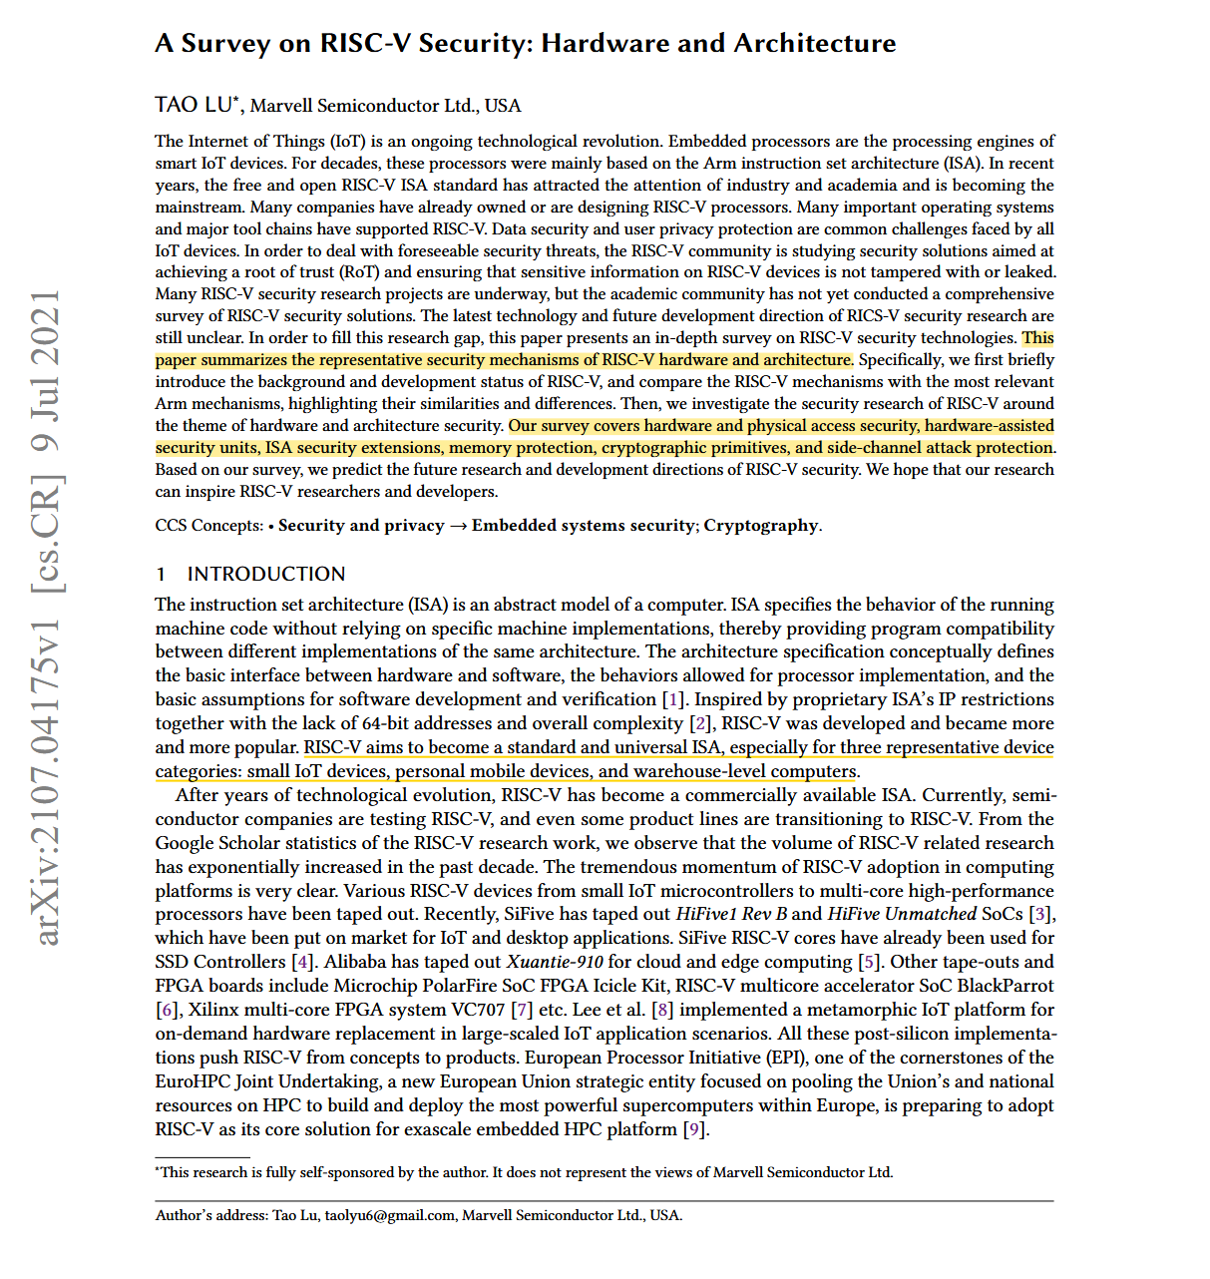
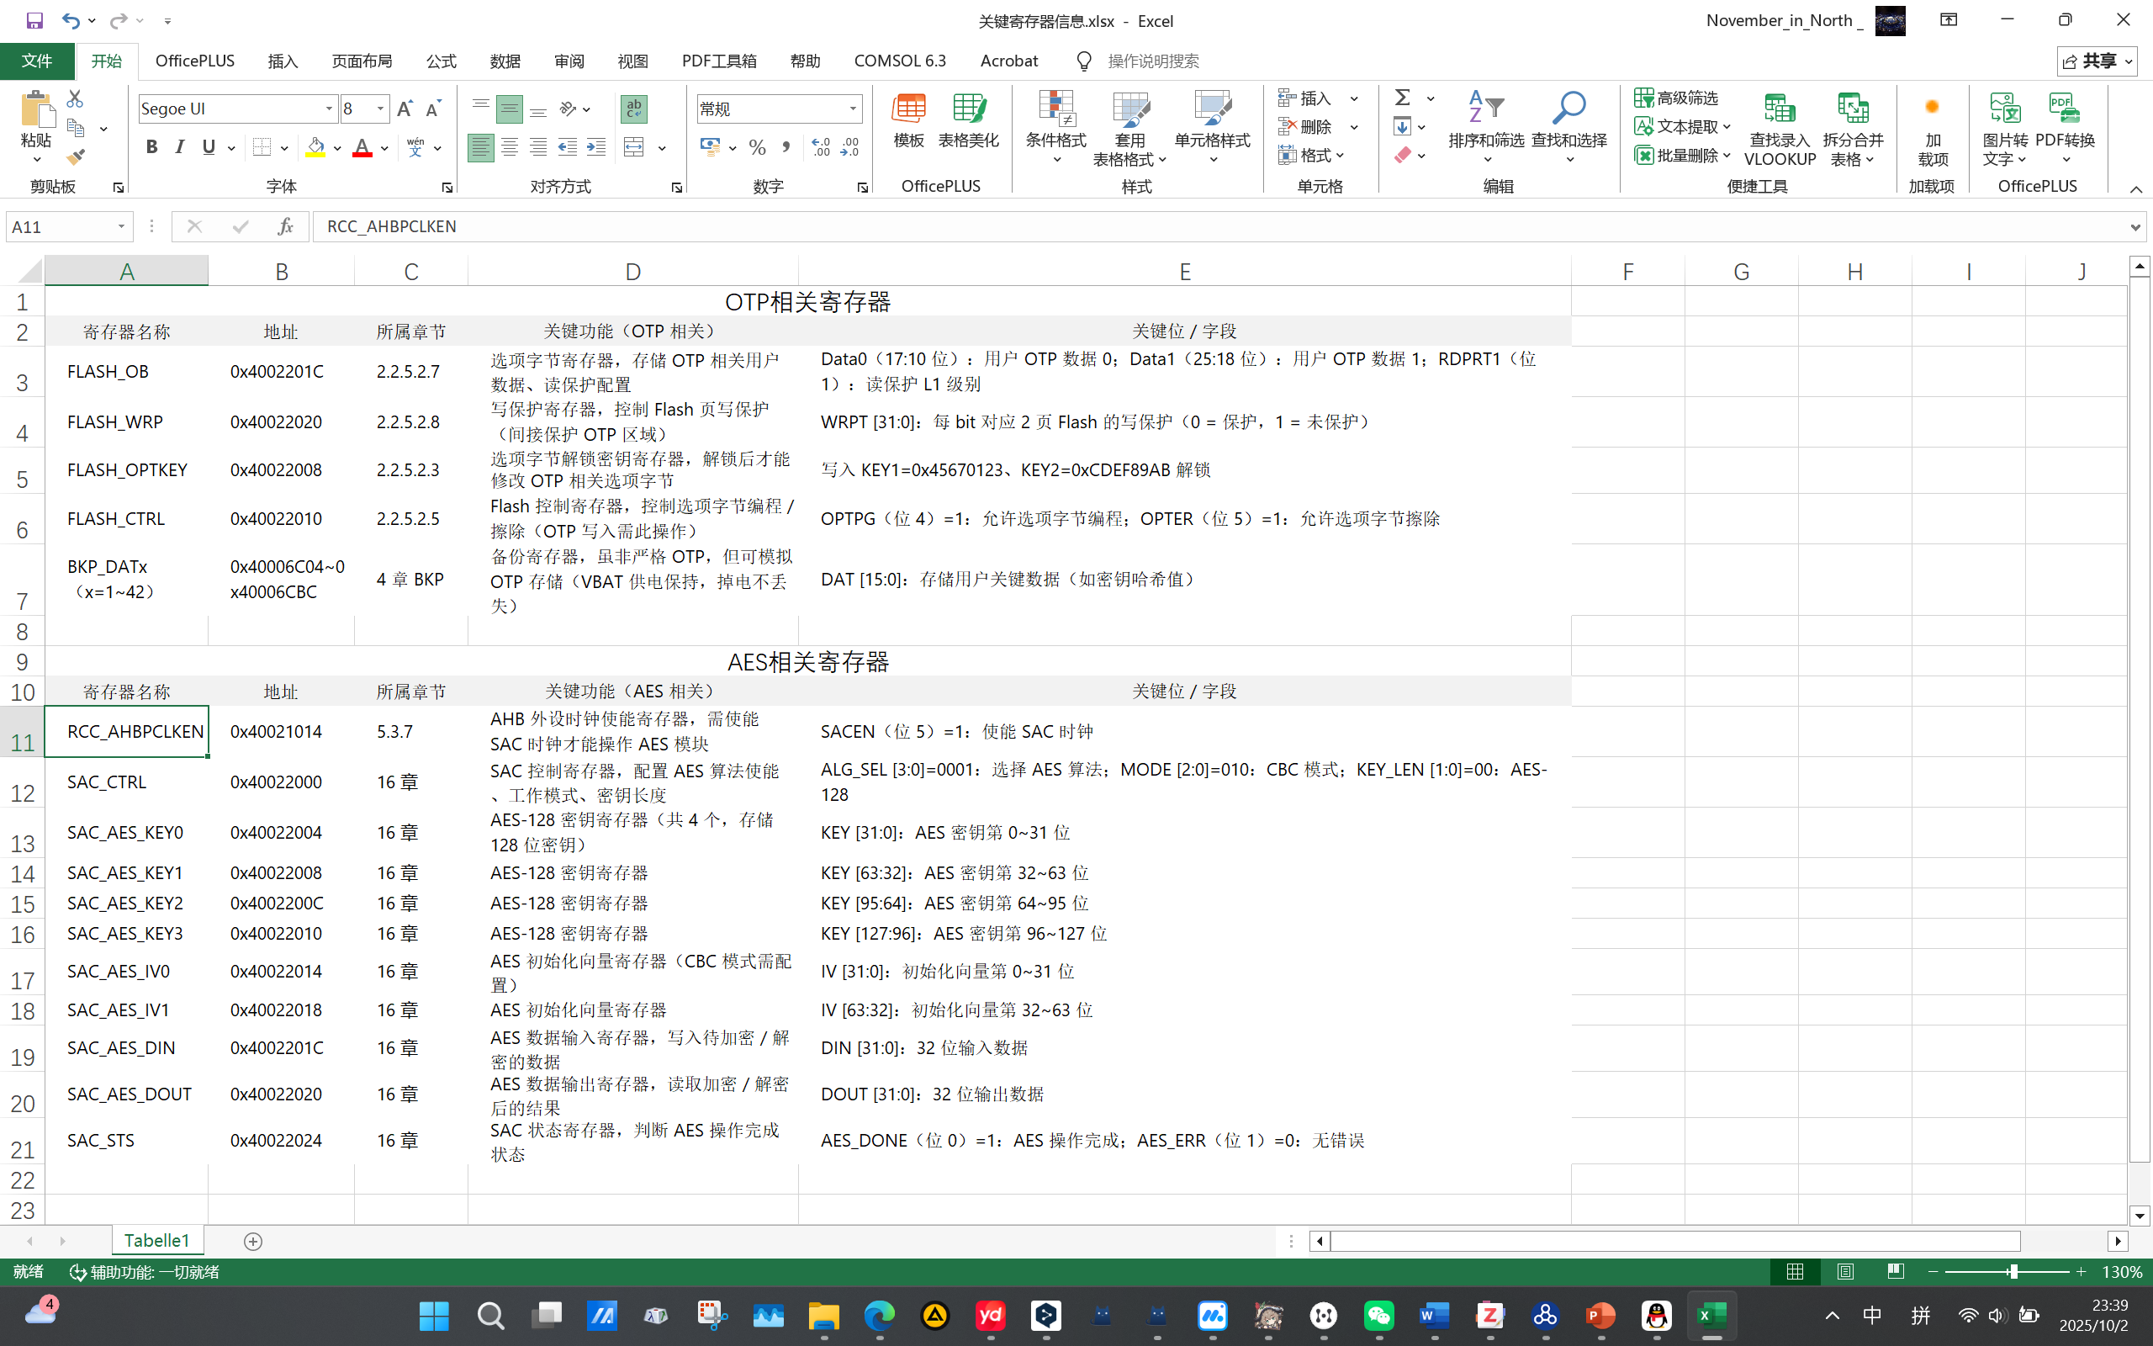
Miscellaneous
Notes of important registers
Literature reading

Slide 17
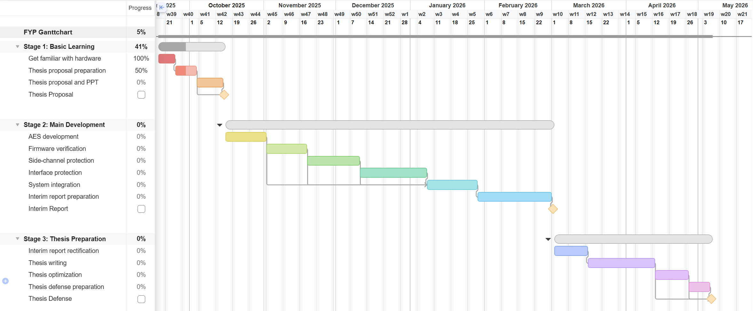
Refreshed Gantt Chart

Slide 18
Oct. 4 – Oct. 24 2025 Week 5-6 Progress
Thesis Proposal & Hardware AES-128 Implement

Slide 19
Refreshed FYP & Thesis Proposal on Oct. 15
Remove
Add
Interface protection
Ascon software implement
SAC-accelerated SLH-DSA implement
Using SLH-DSA for firmware verification
Using TVLA test for side-channel protection

Slide 20
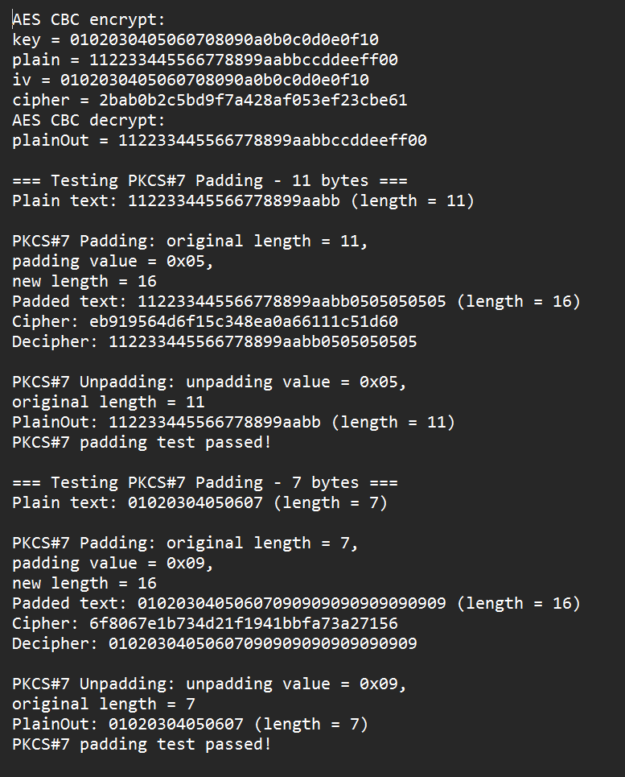
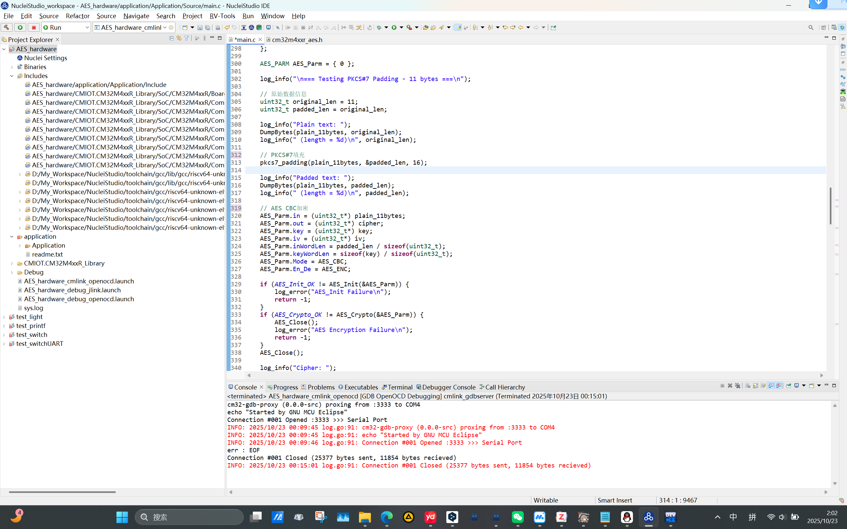
AES Hardware Implement – Basic SAC function & PKCS#7 padding

Slide 21
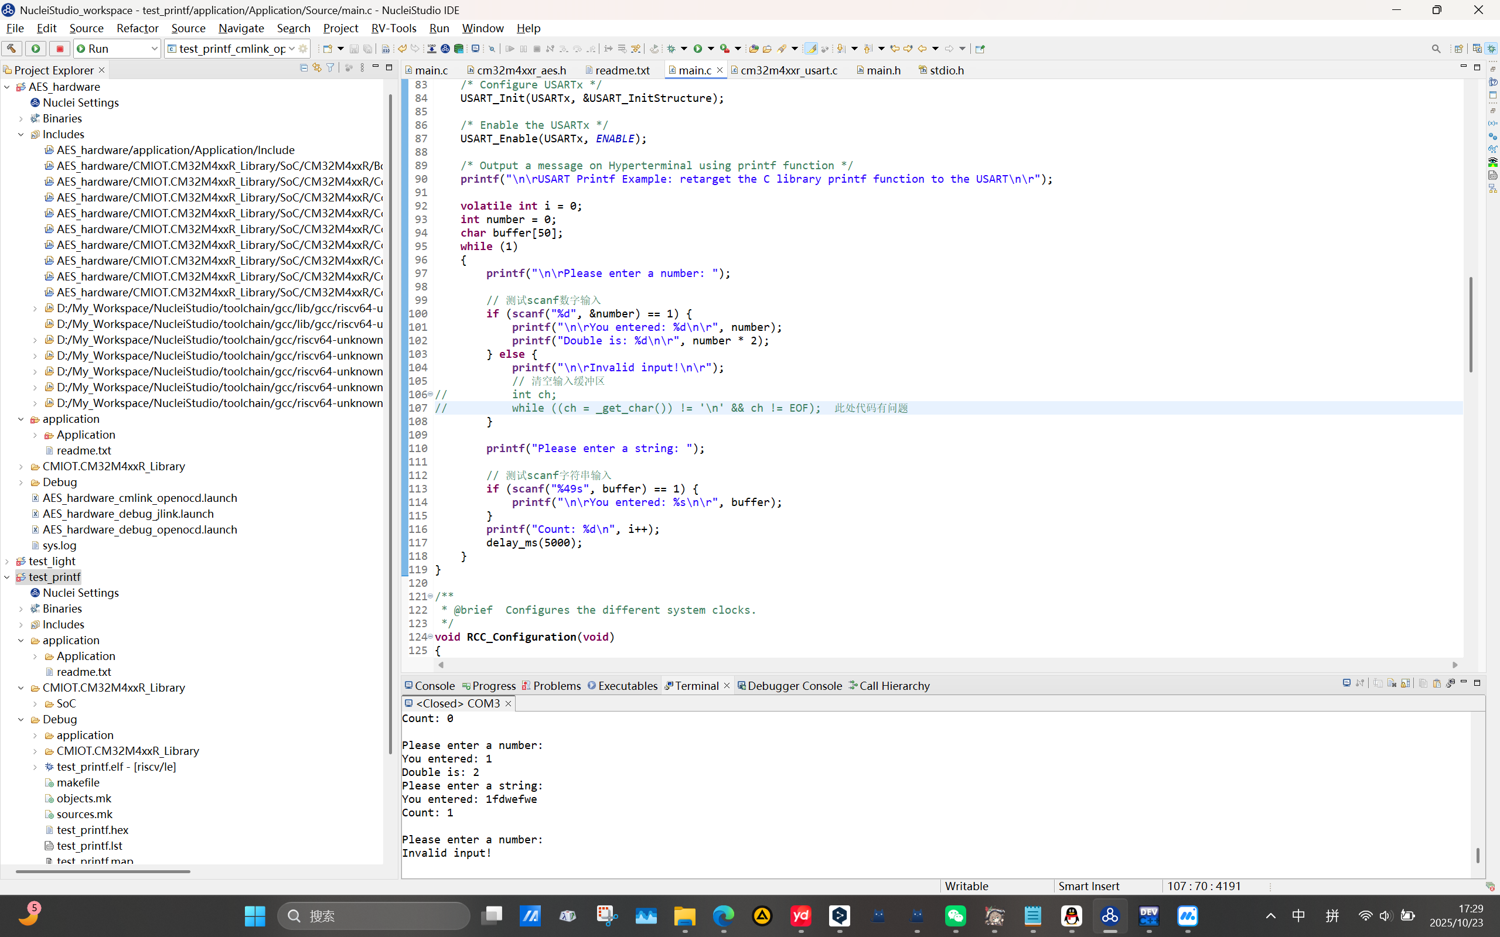
Redirect _get_char() to achieve scanf() function

Slide 22
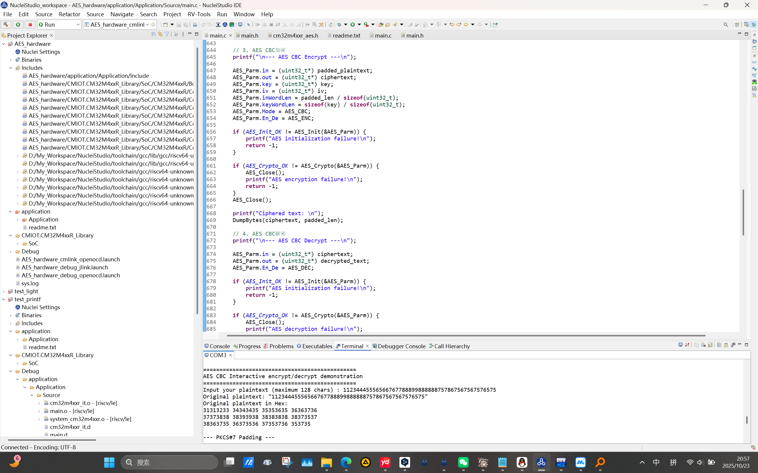
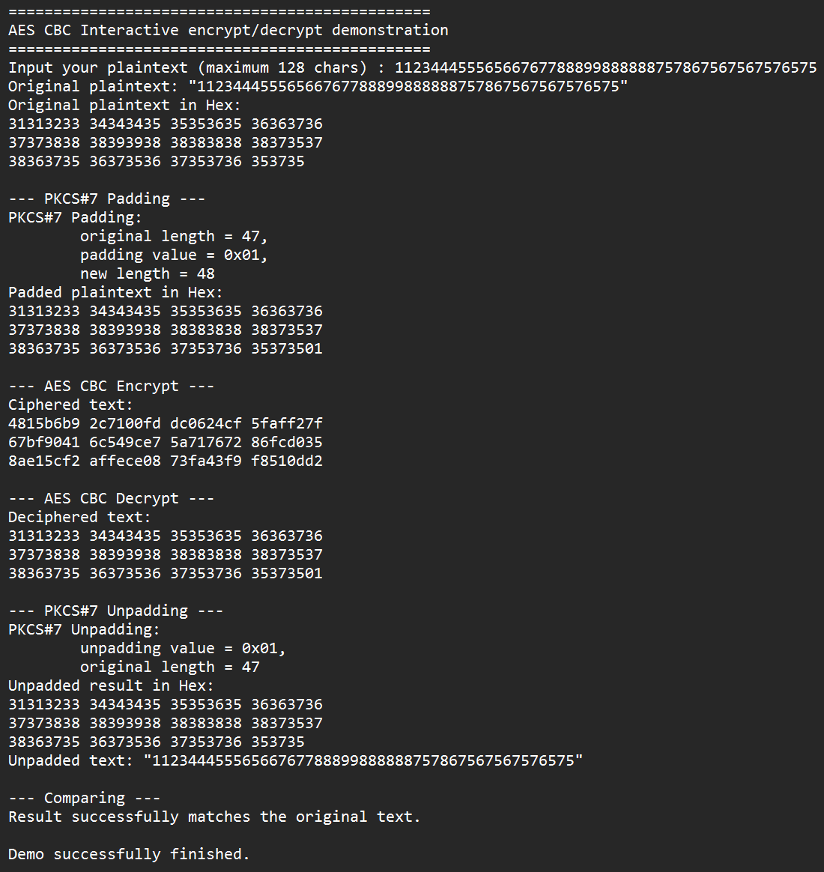
AES Hardware Implement – Introduce scanf() & customized plaintext

Slide 23
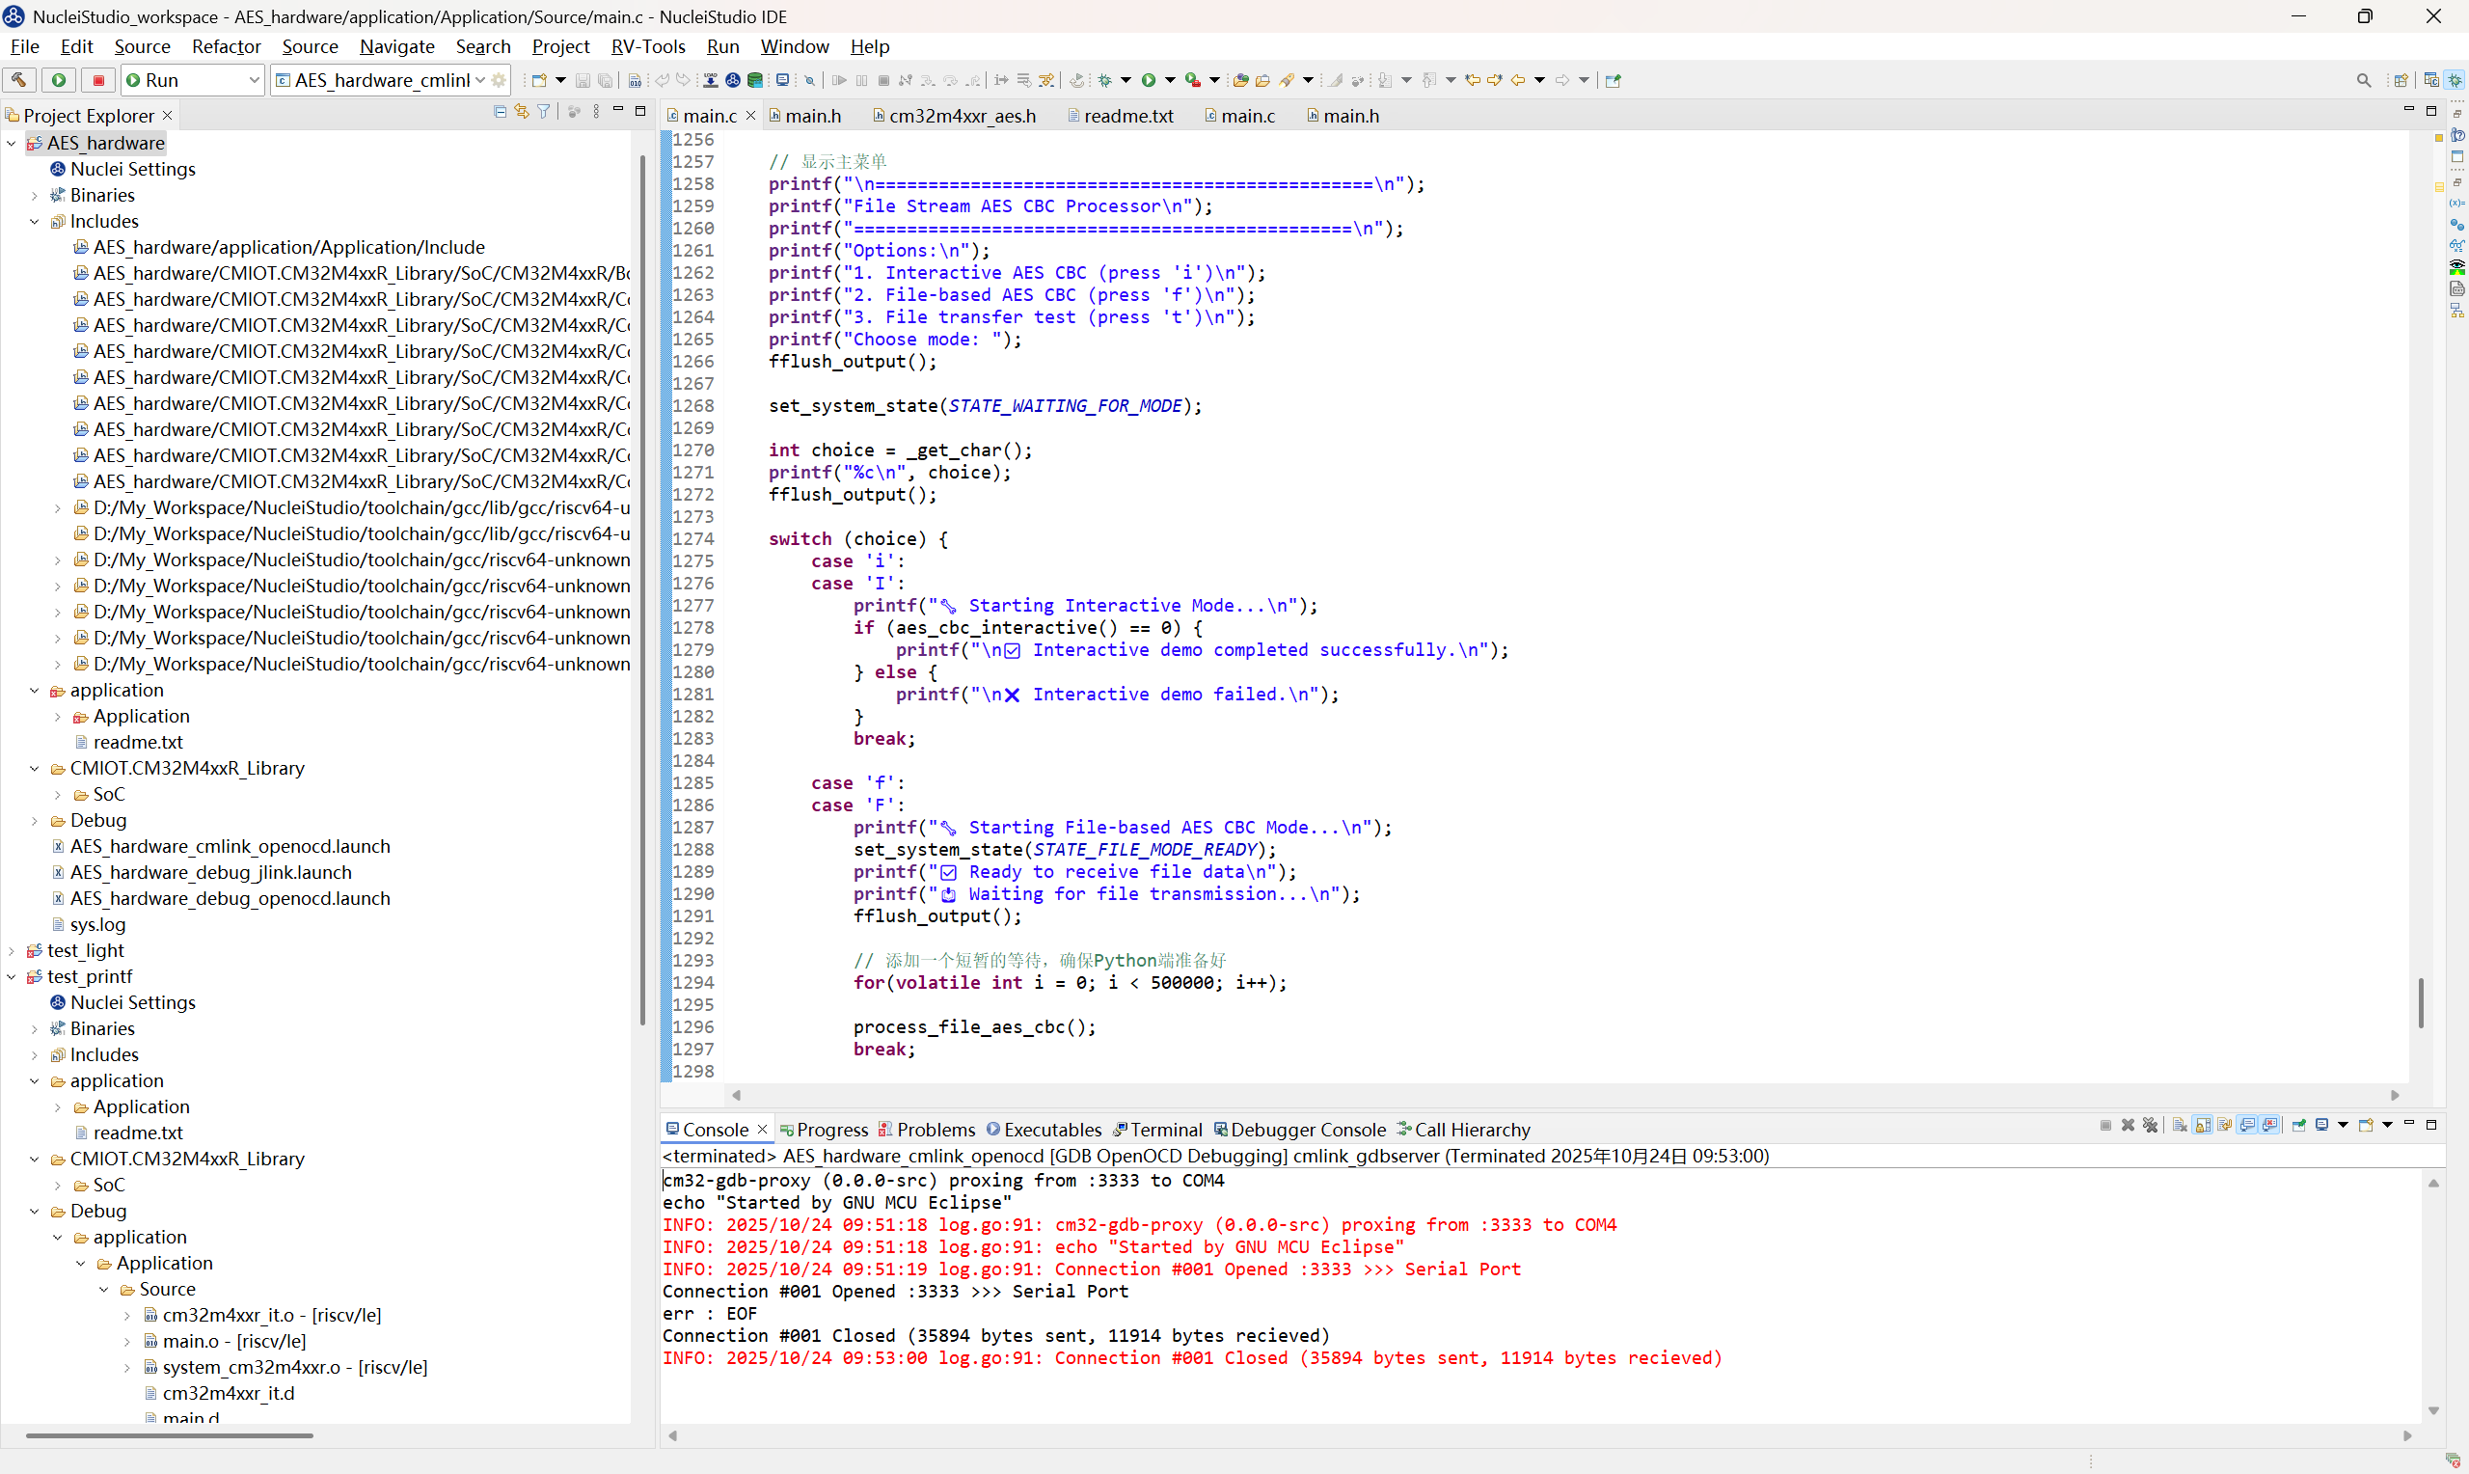
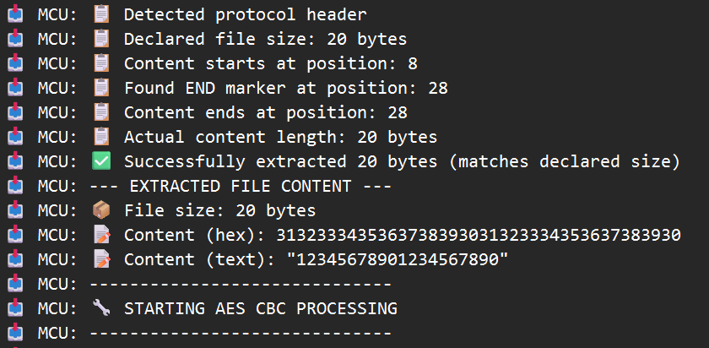
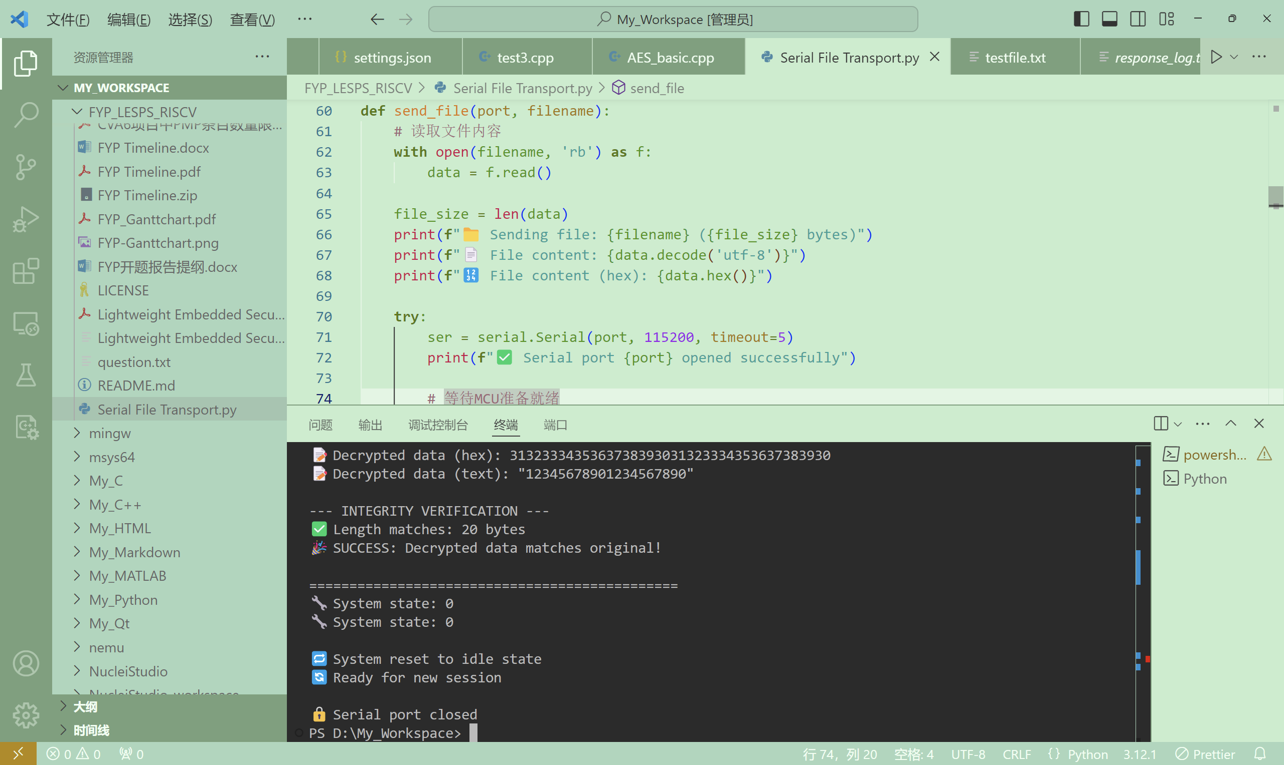
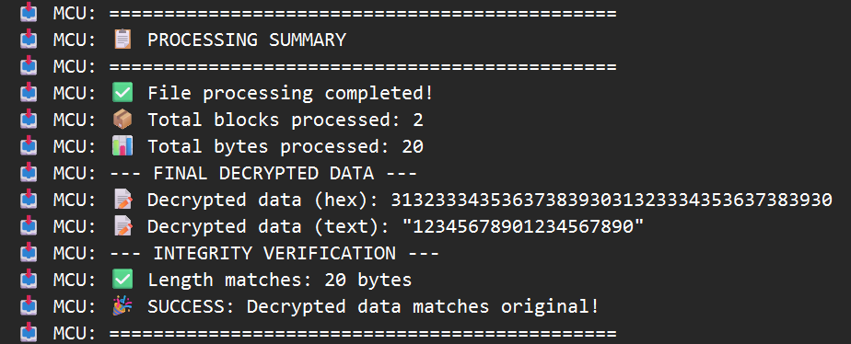
AES Hardware Implement – File Transport

Slide 24
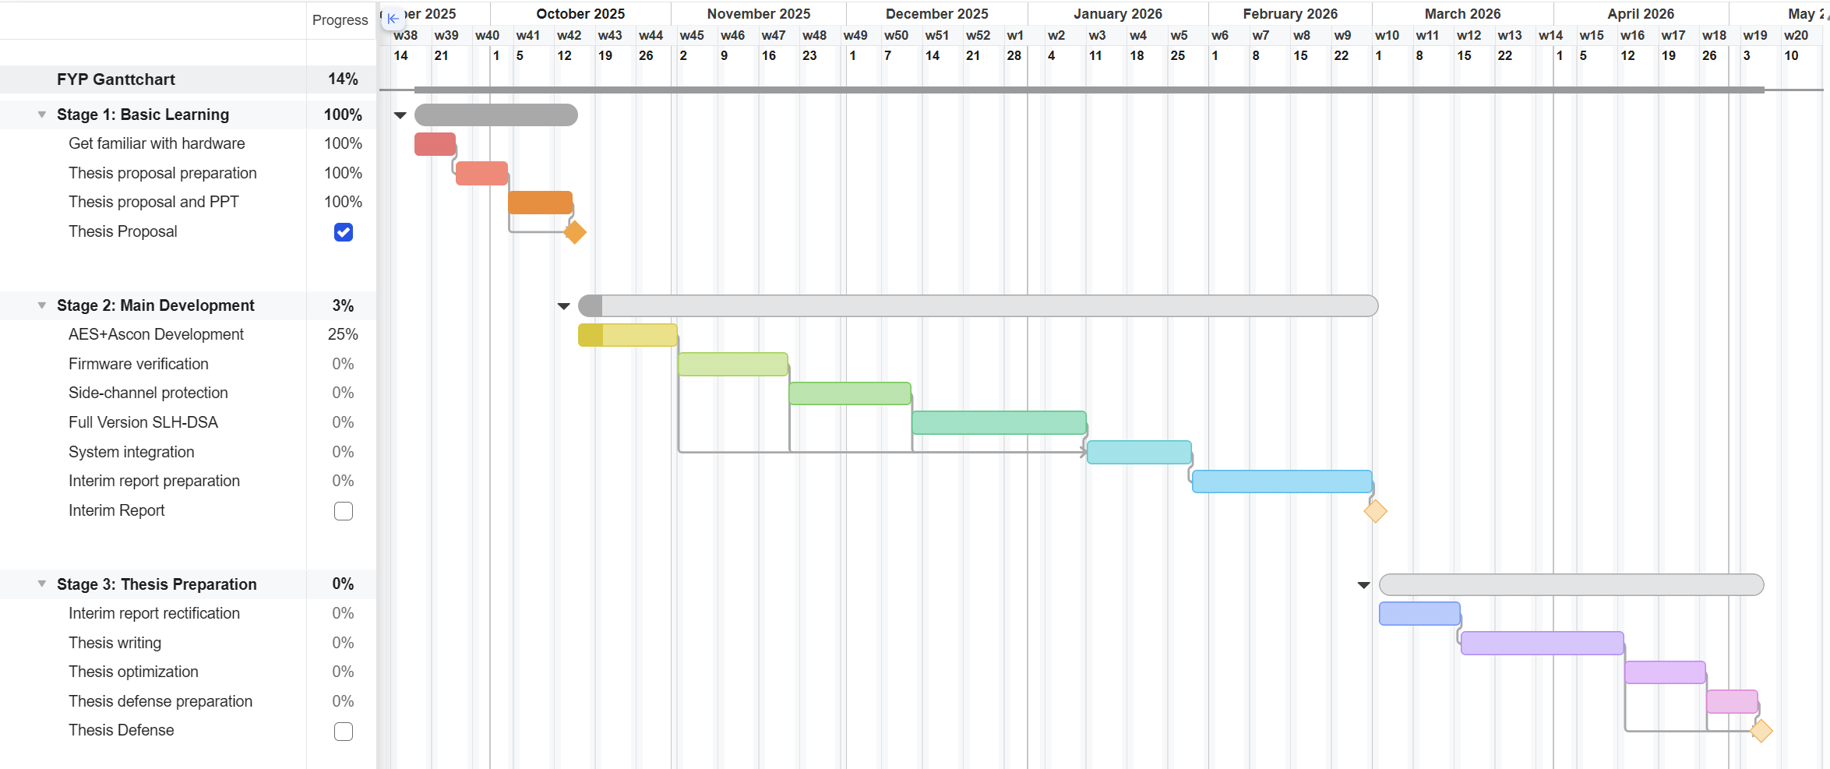
Refreshed Gantt Chart

Slide 25
Oct. 25 – Nov. 7 2025 Week 7-8 Progress
Hardware AES-128 Implement

Slide 26
Hardware AES – Large File Support
Old version
This version
Only support files that are less than 512 bytes
Immediately decrypt after encryption
Cannot save ciphered / deciphered text
Possible memory leakage in data transmission
Support files of ANY size
Decoupled operation
Can save ciphertext and output
Strict data size check during transmission

Slide 27
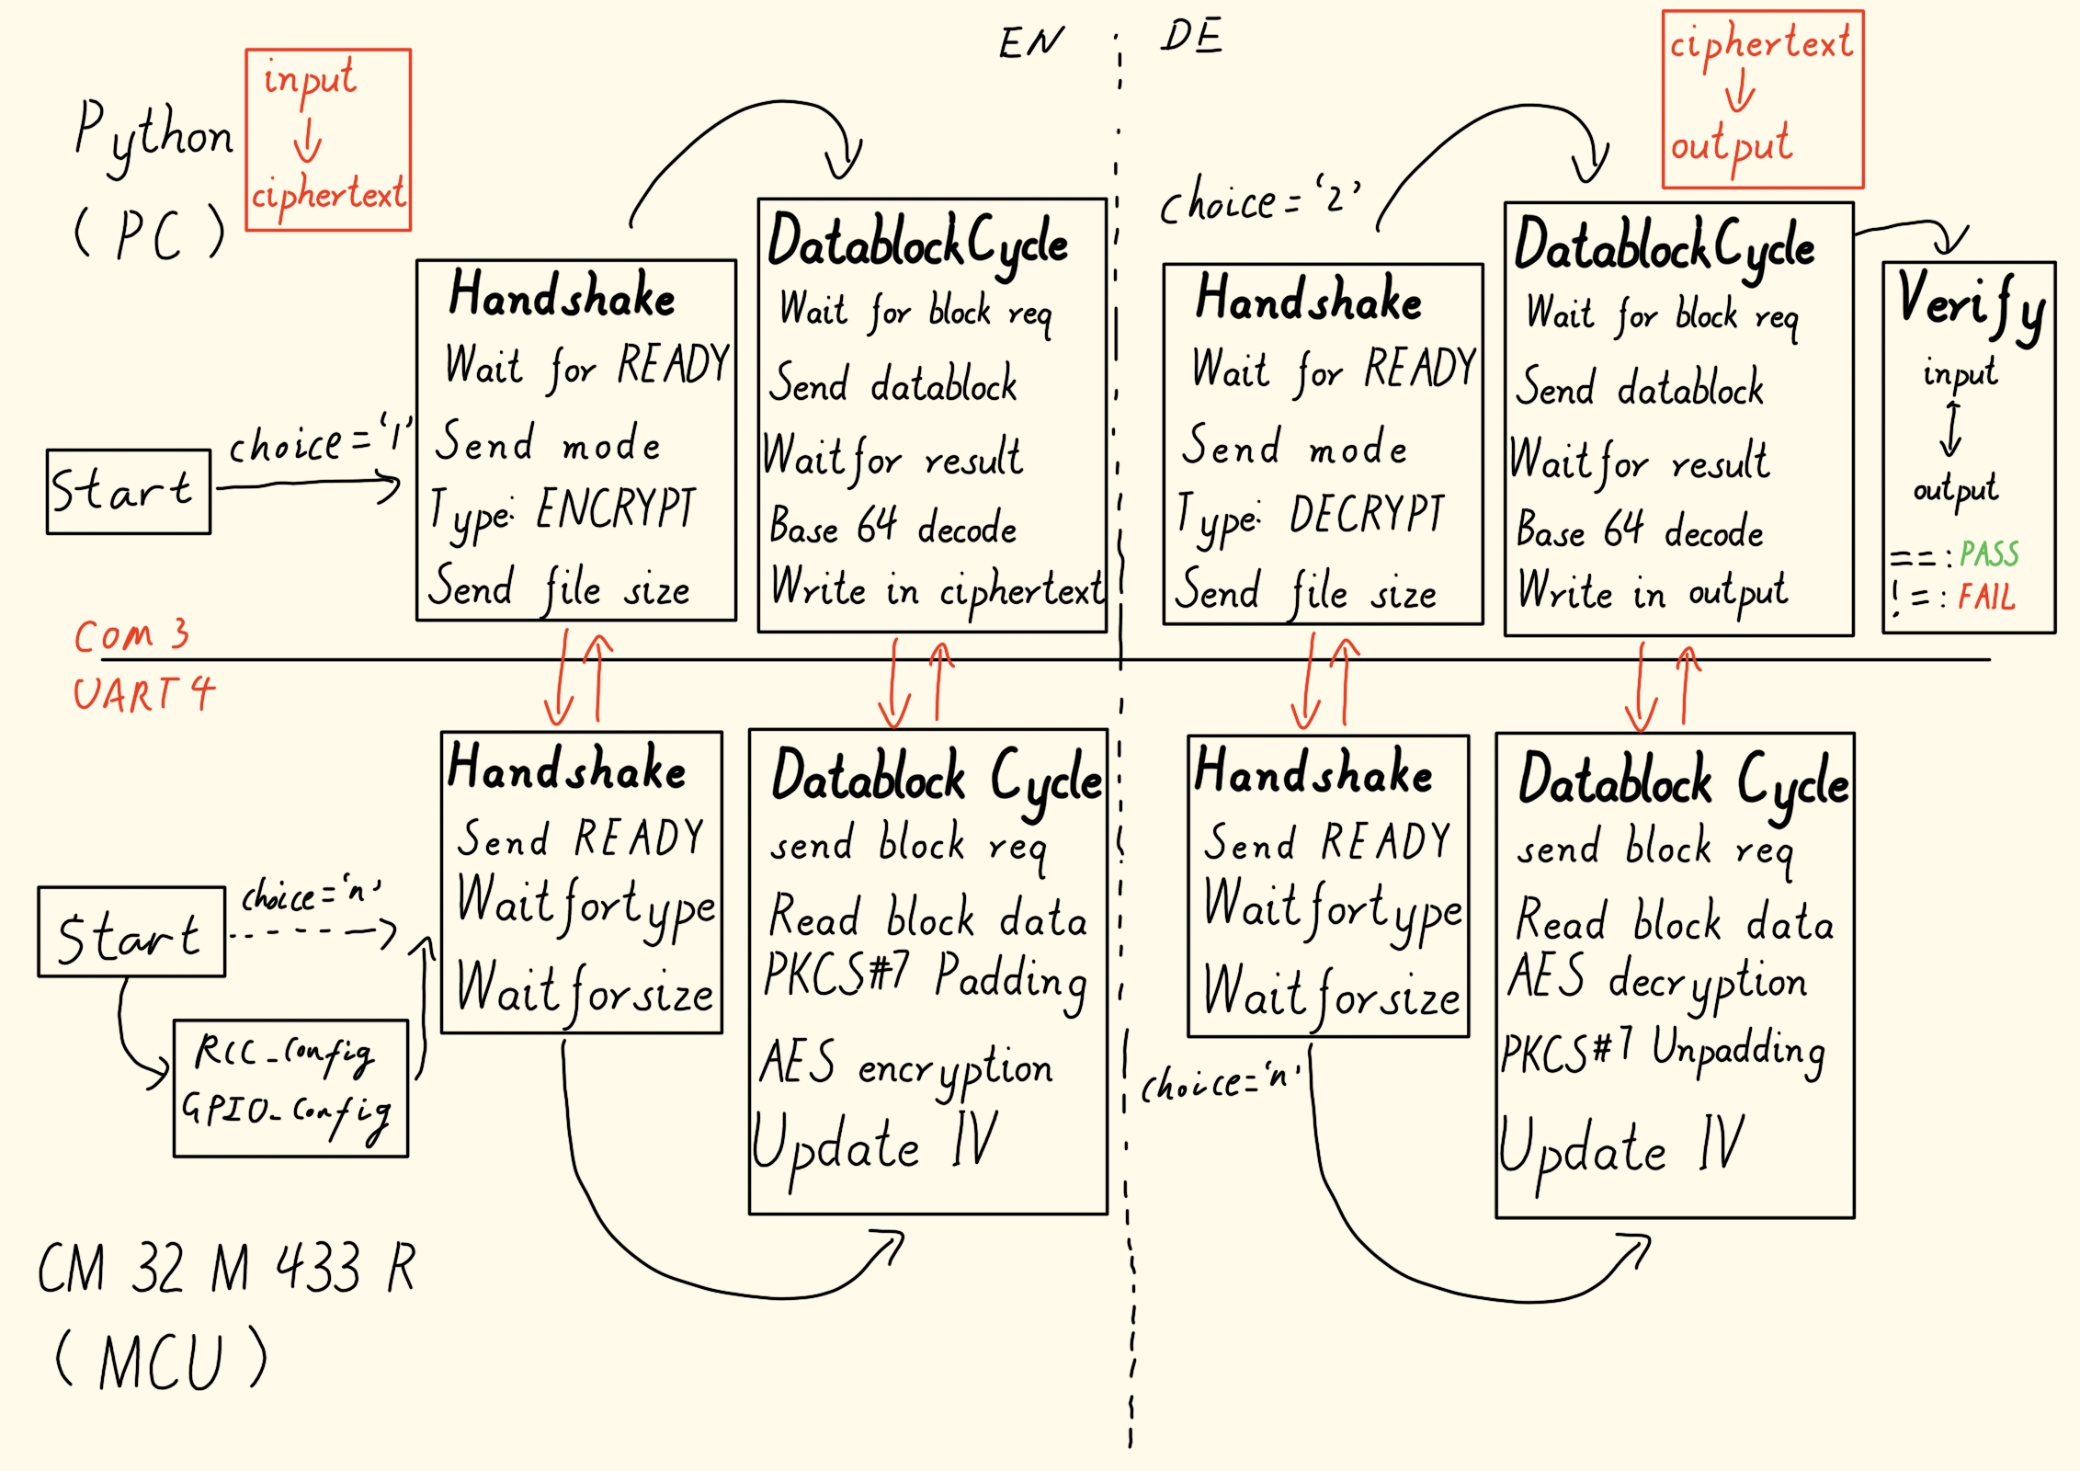
Hardware AES – Large File Support

Slide 28
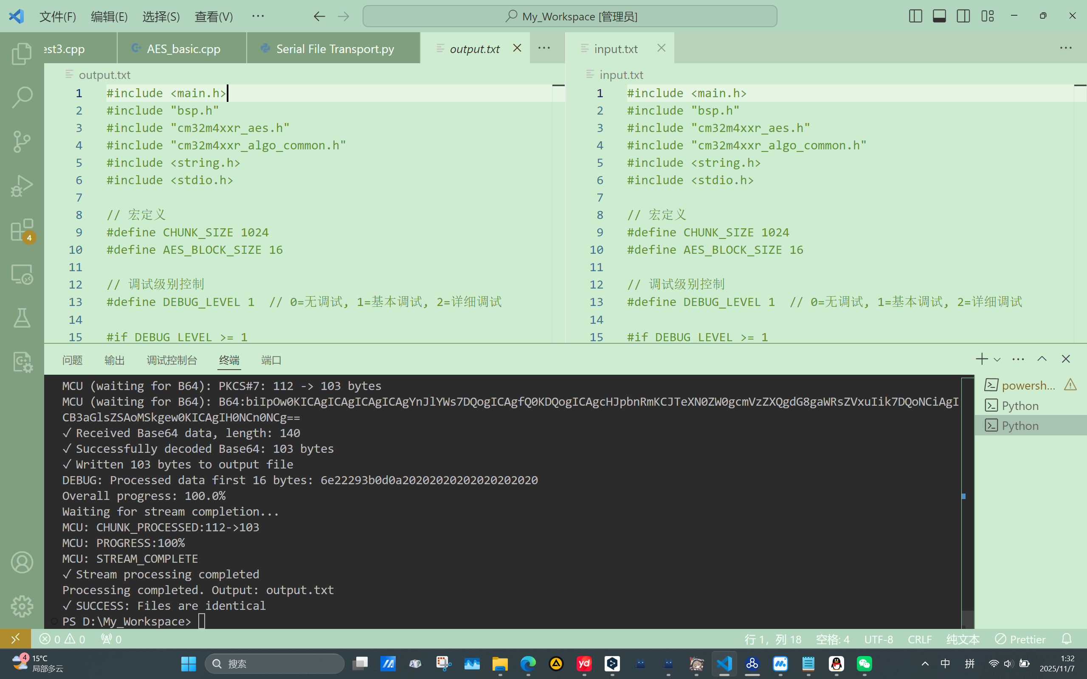
Hardware AES – Large File Support

Slide 29
Further step…
Based on the hardware AES implementation, replace the hardware AES to software AES and software Ascon
Benchmark on all the implementations and make a comparison
Move on to firmware verification part

